Slide 1
MND 500 Managerial Decision Making
Prof. Siddhartha Agarwal

Slide 2
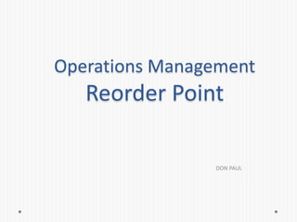

Slide 3
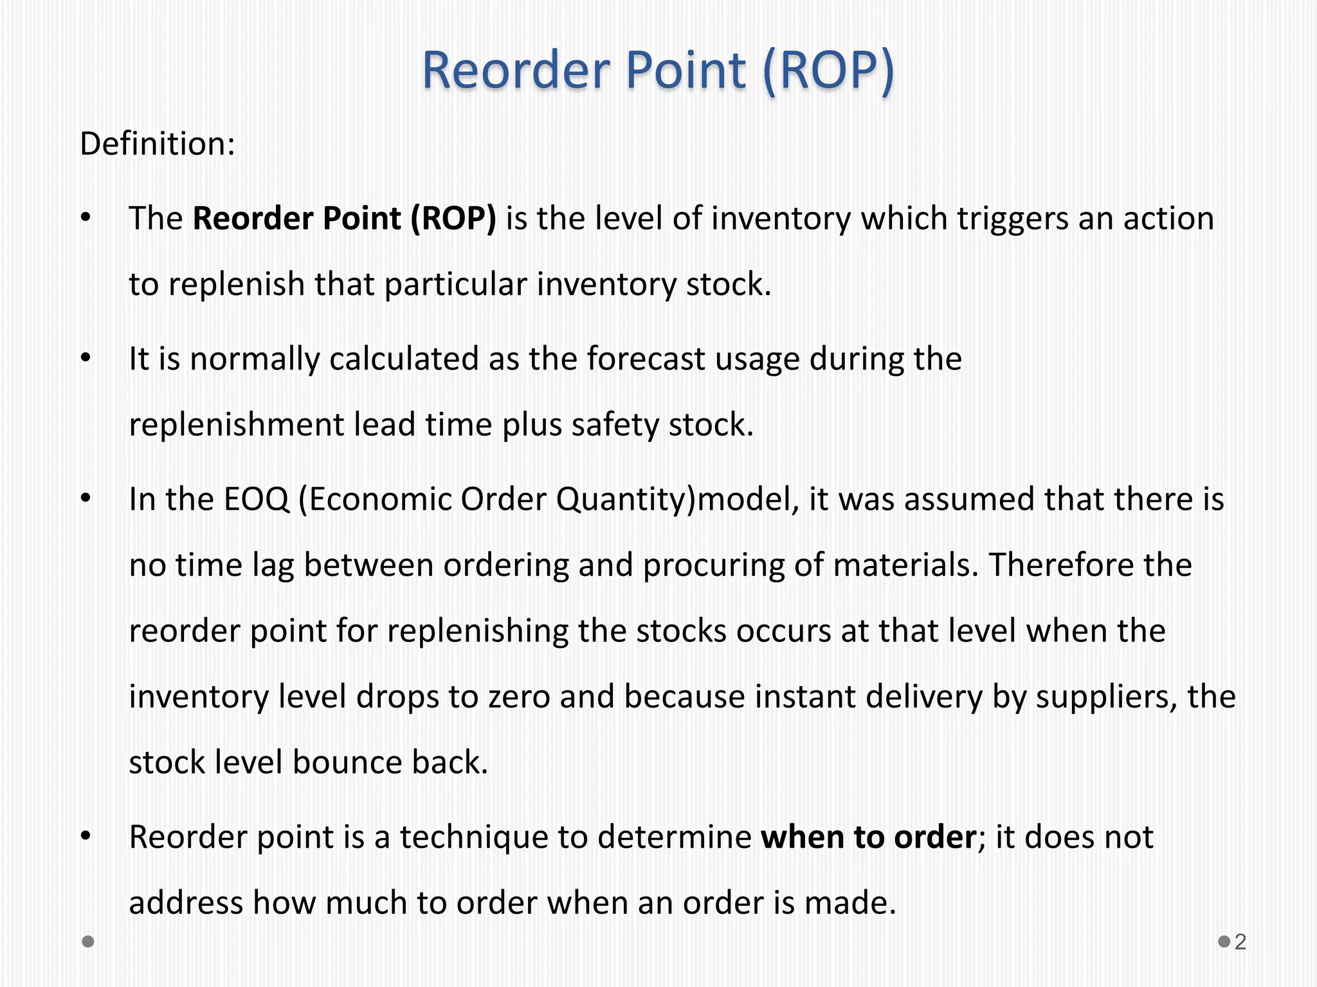

Slide 4
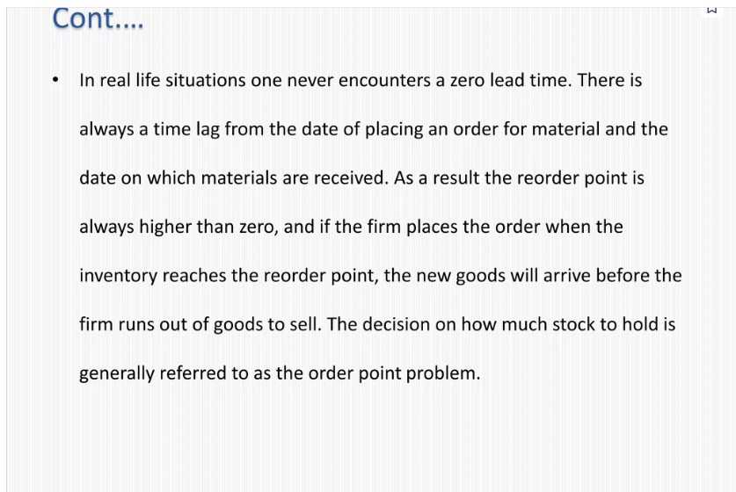

Slide 5
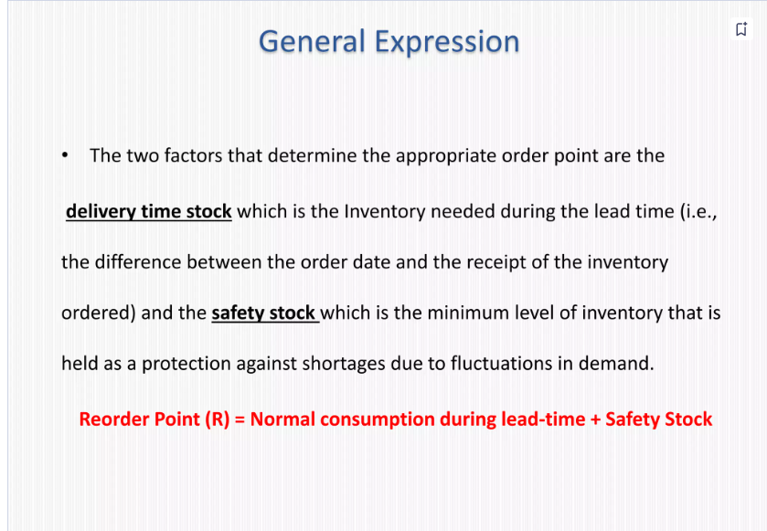

Slide 6
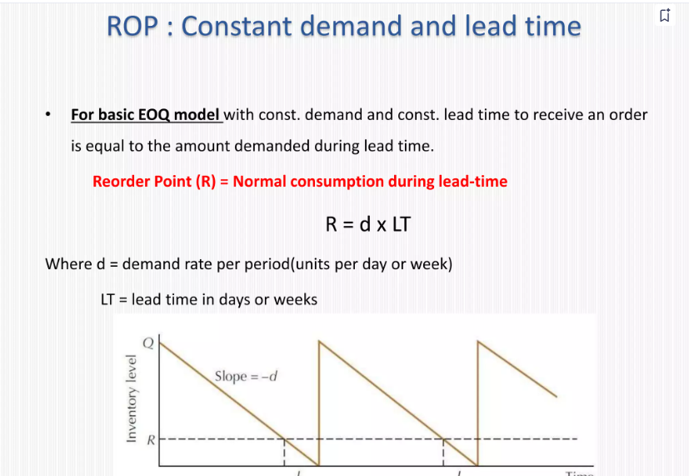

Slide 7
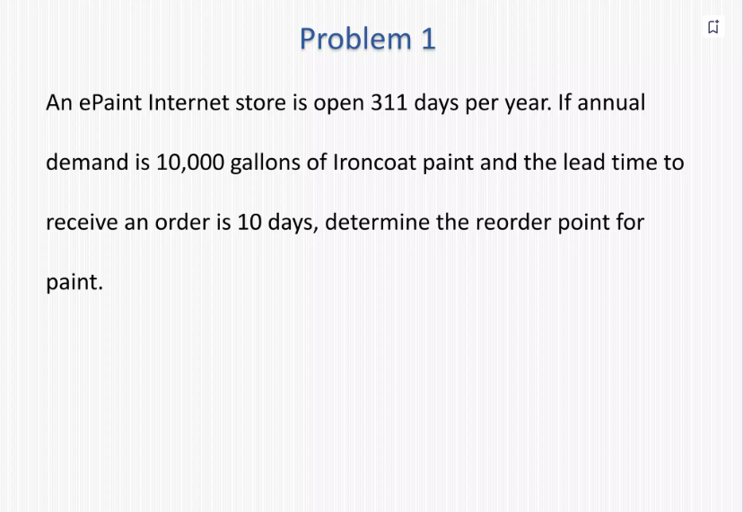

Slide 8
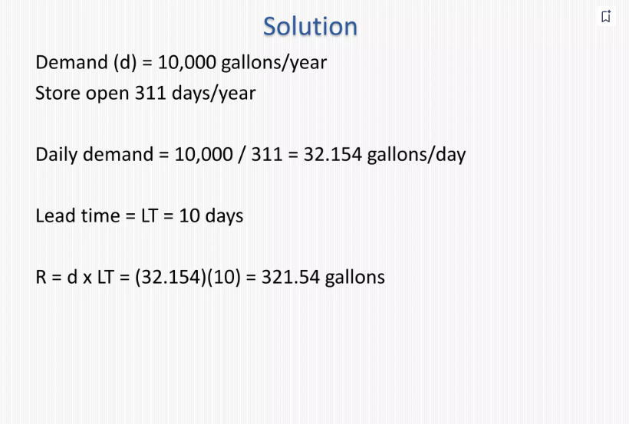

Slide 9
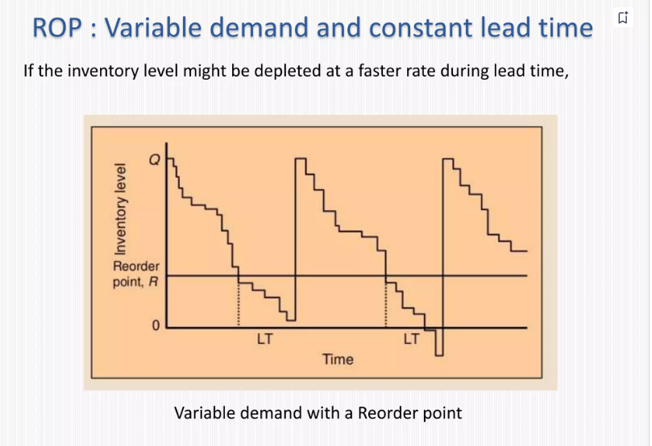

Slide 10
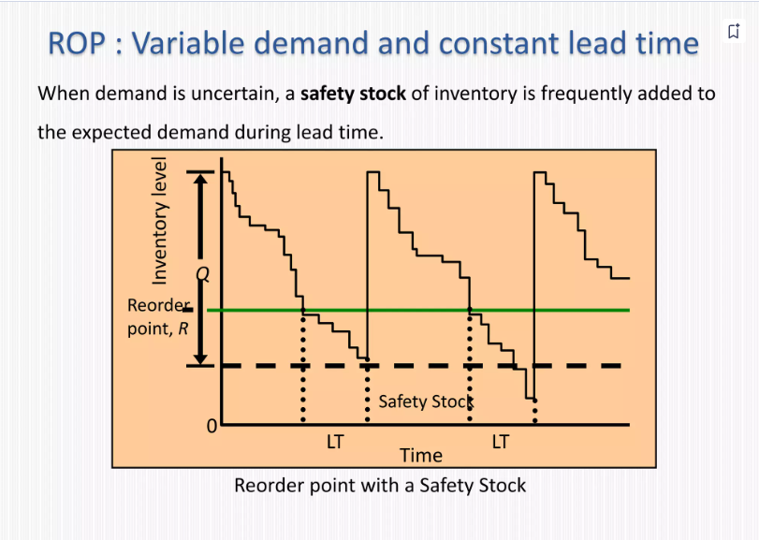

Slide 11
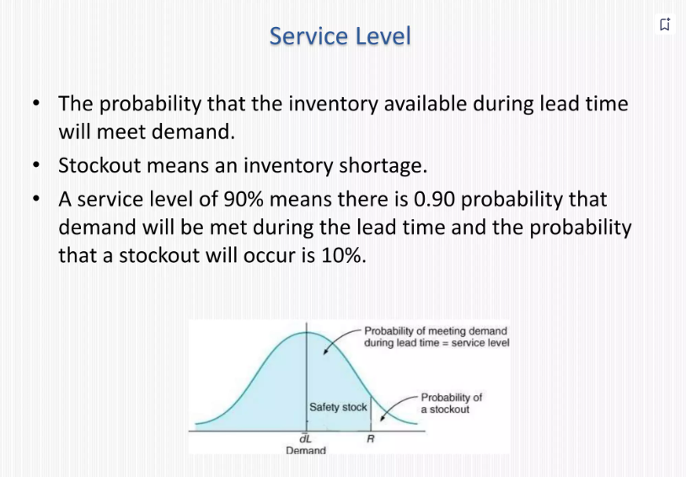

Slide 12
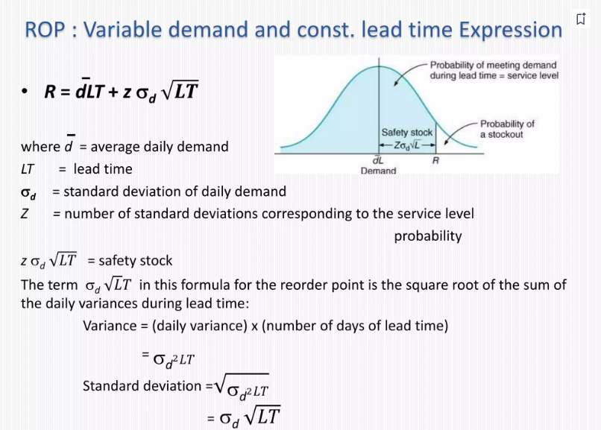

Slide 13
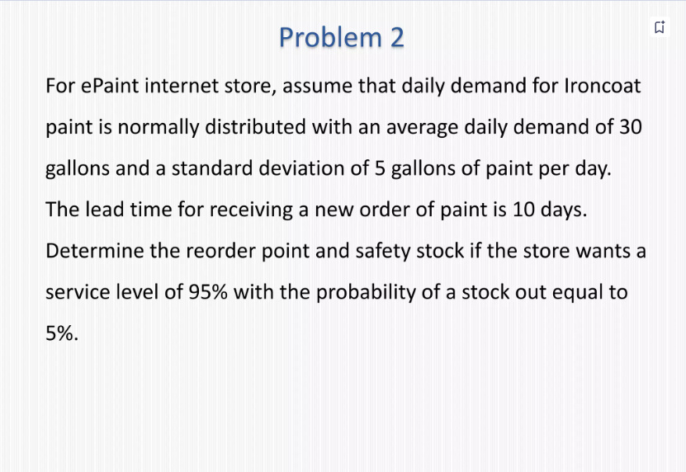

Slide 14
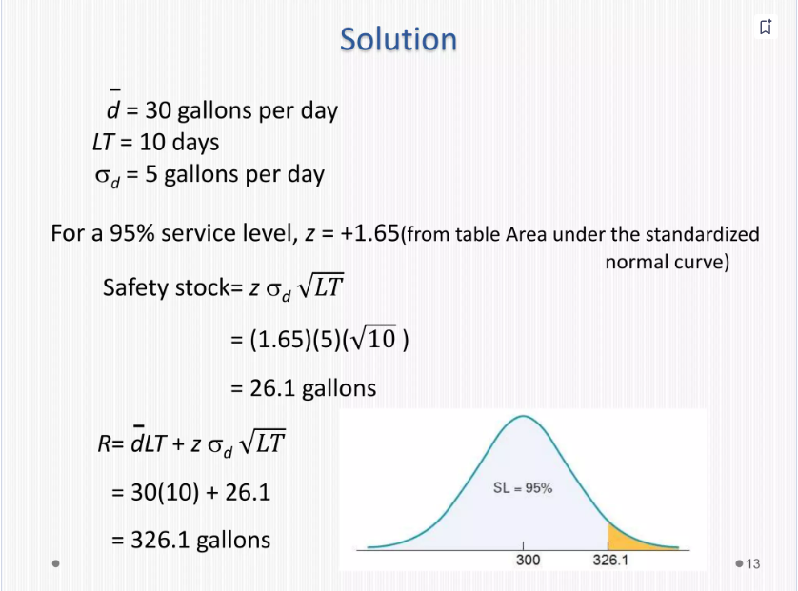

Slide 15
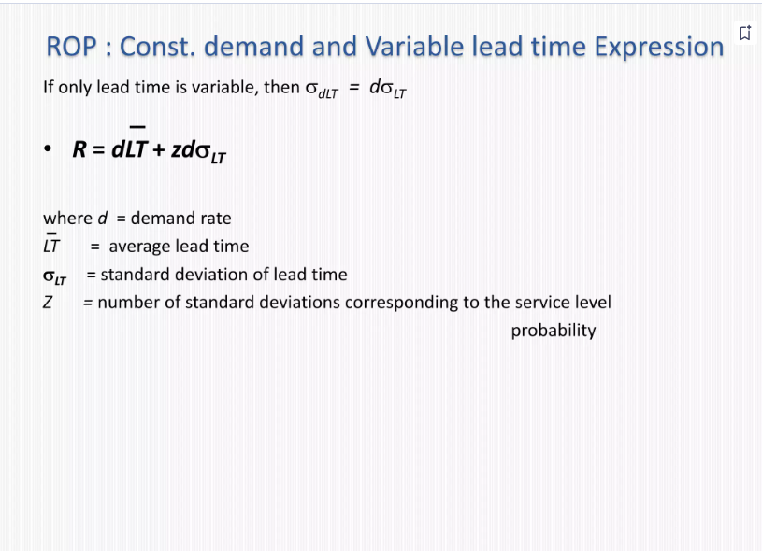

Slide 16
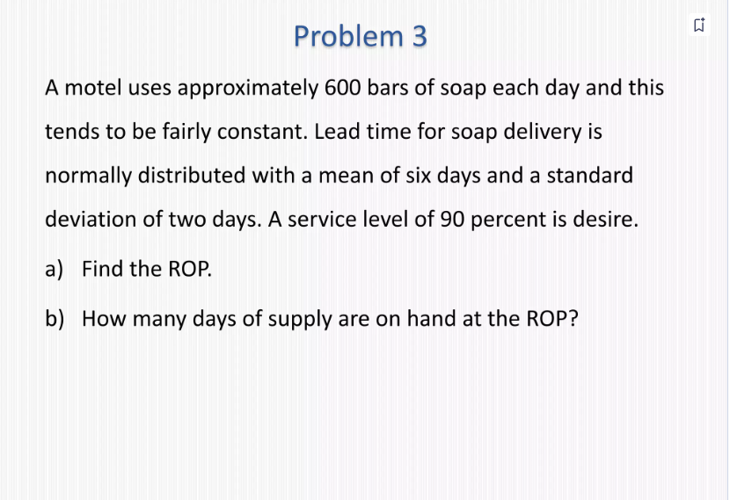

Slide 17
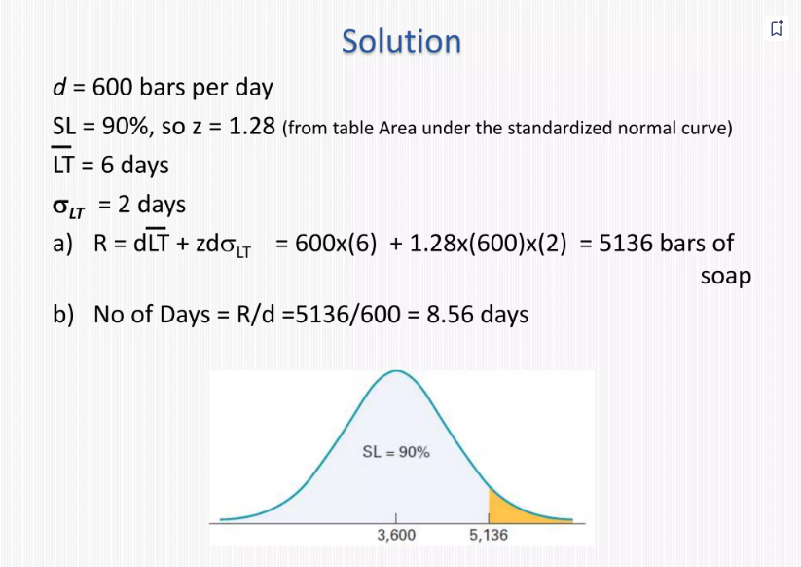

Slide 18
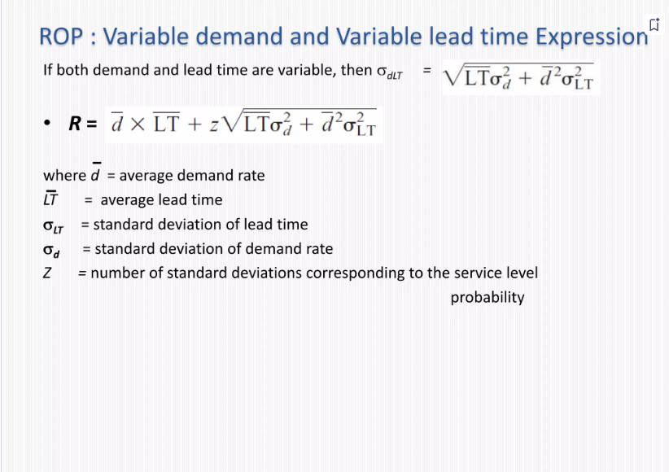

Slide 19
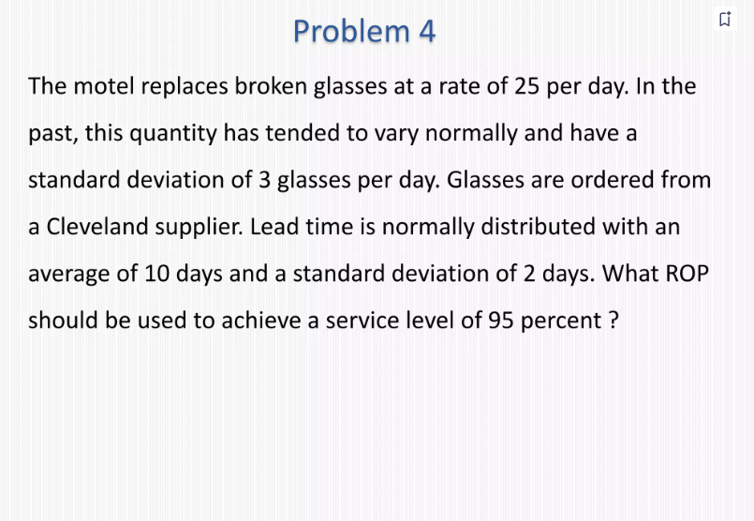

Slide 20
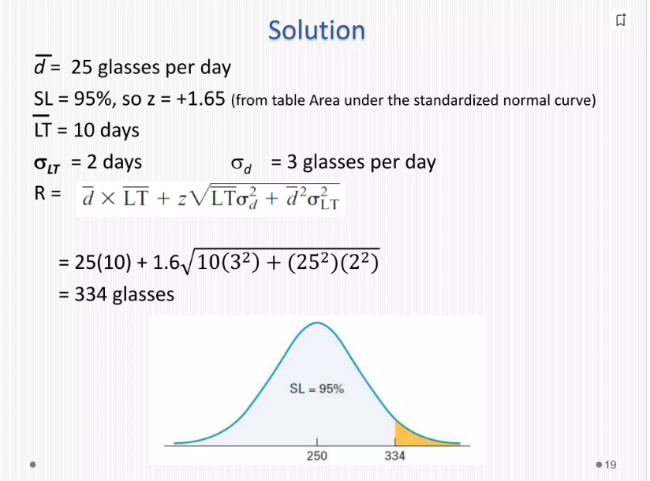

Slide 21
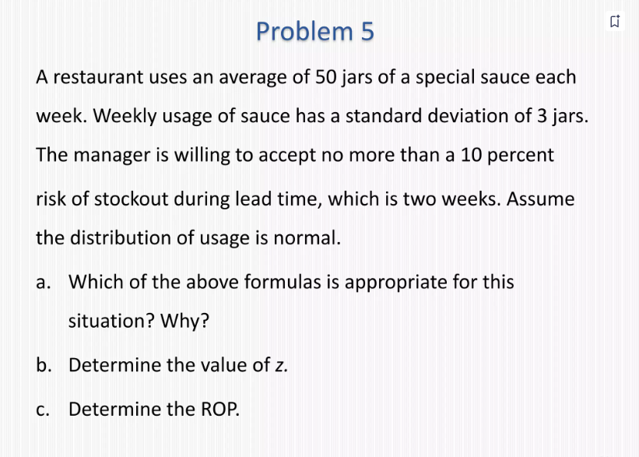

Slide 22
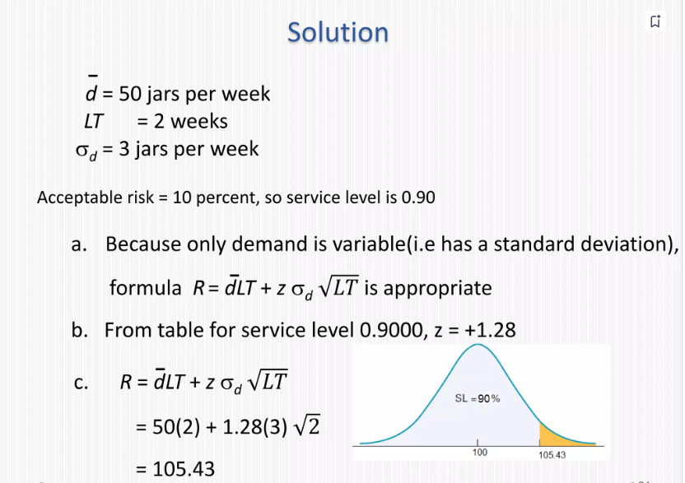

Slide 23
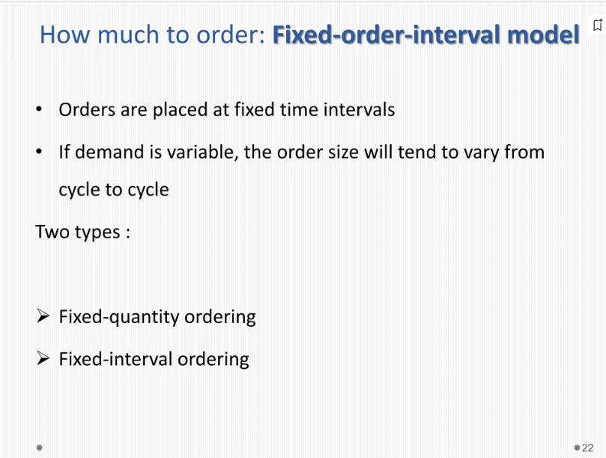

Slide 24
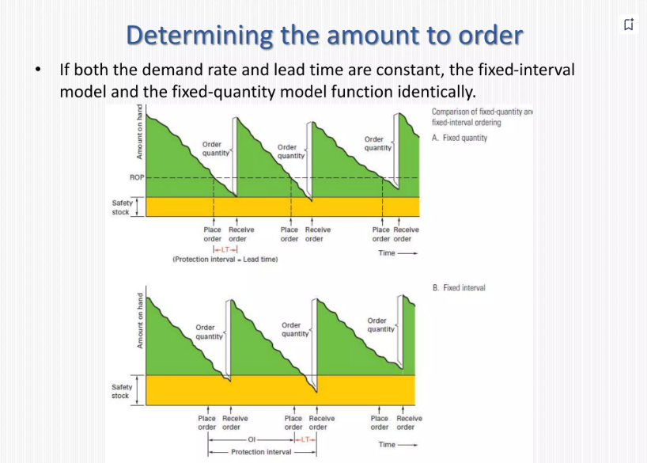

Slide 25
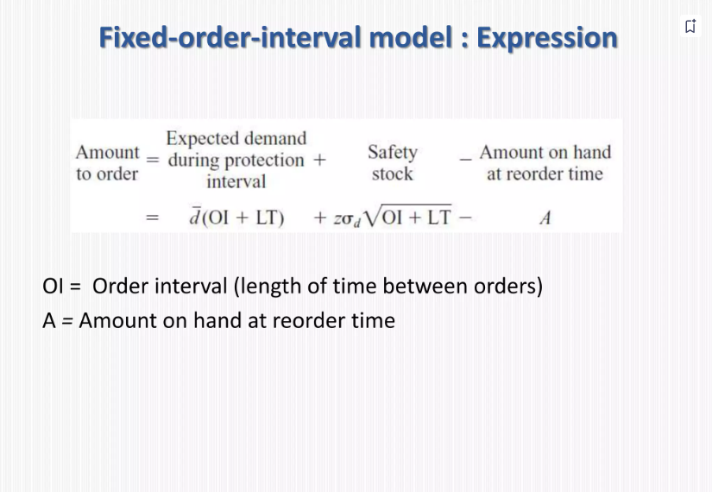

Slide 26
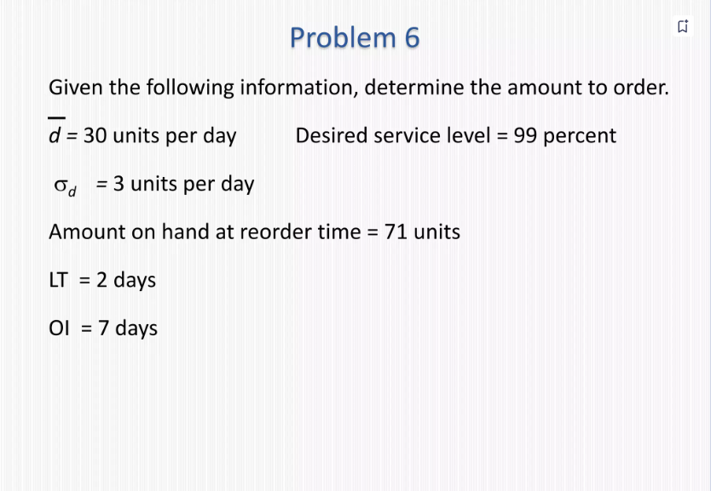

Slide 27
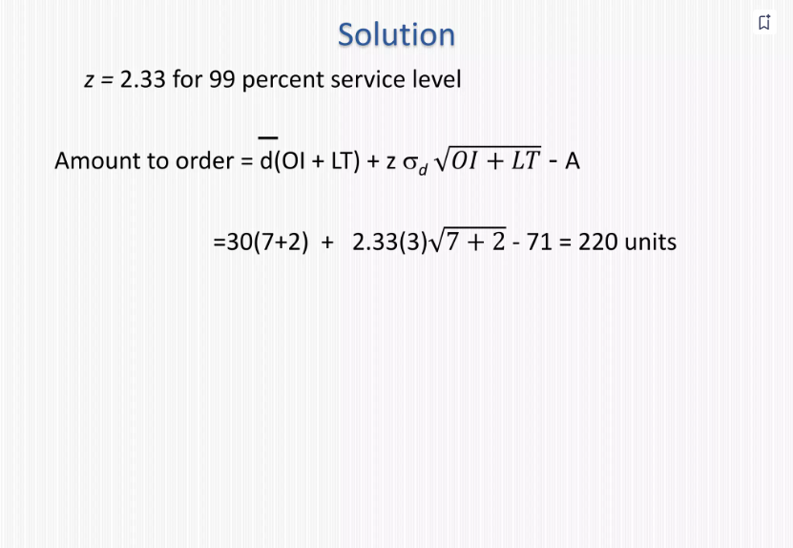

Slide 28
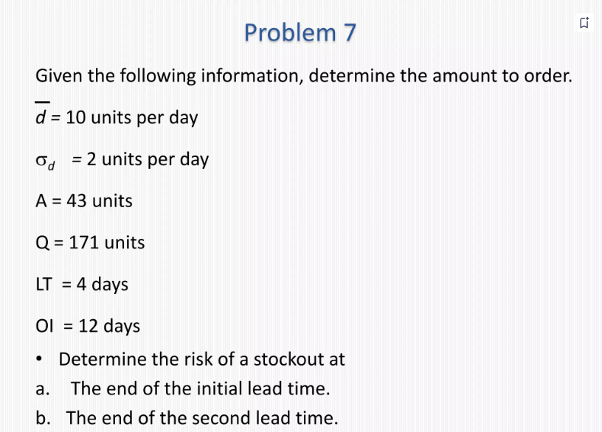

Slide 29
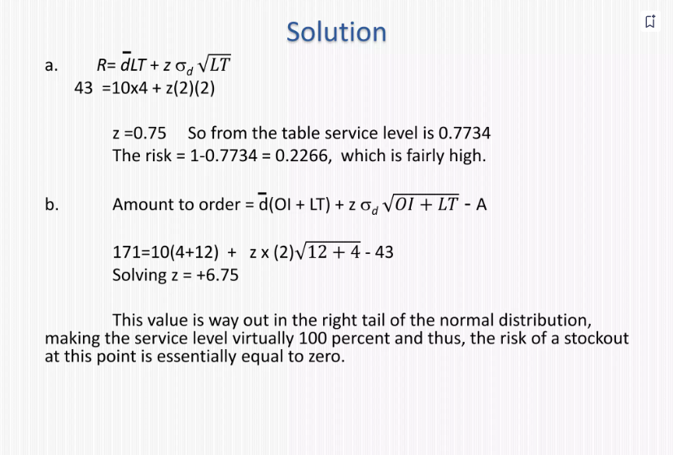

Slide 30
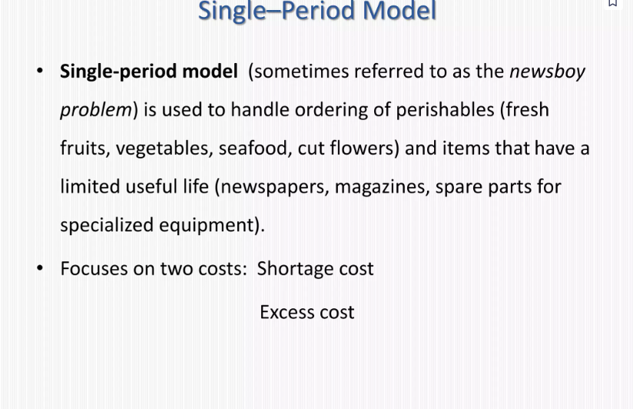

Slide 31
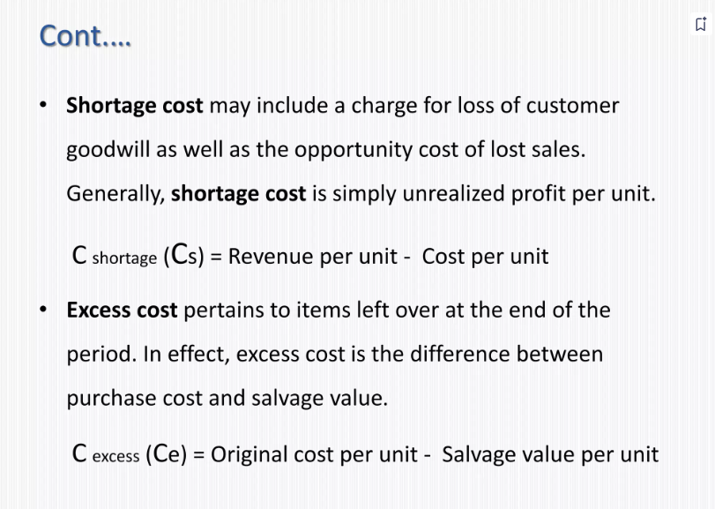

Slide 32
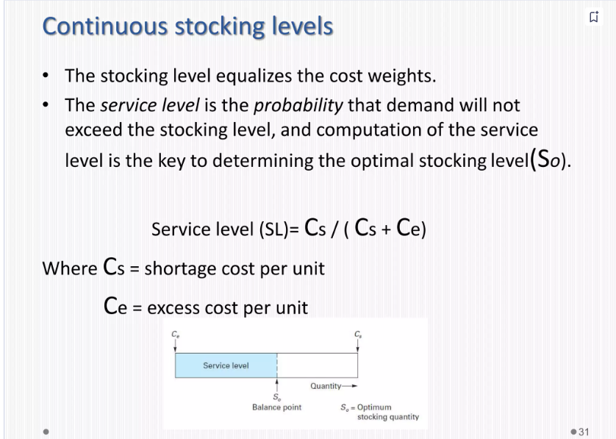

Slide 33
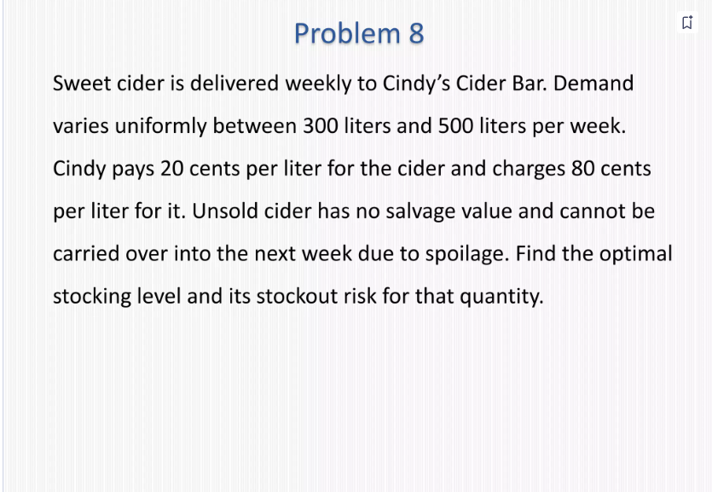

Slide 34
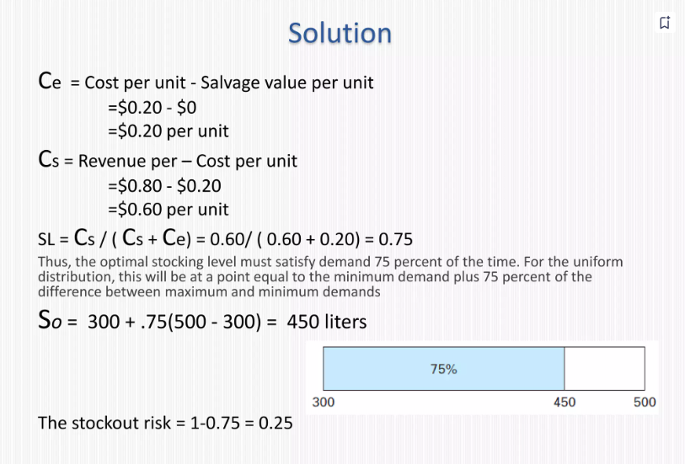

Slide 35
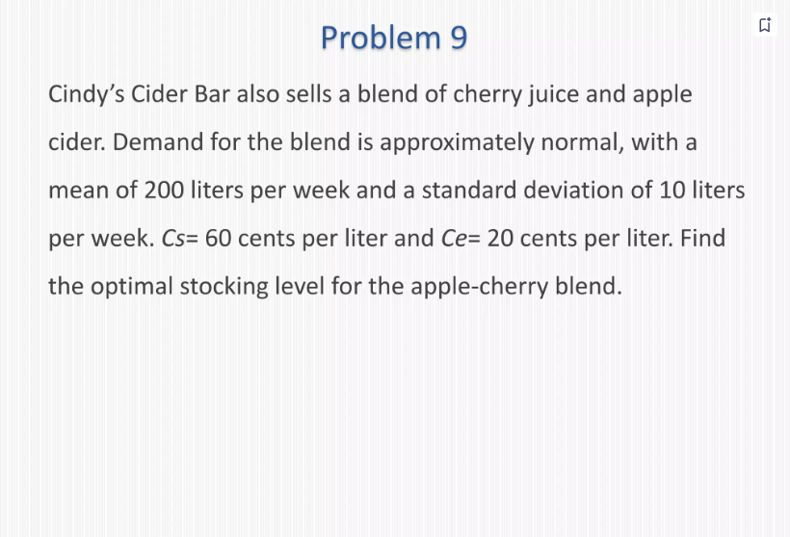

Slide 36
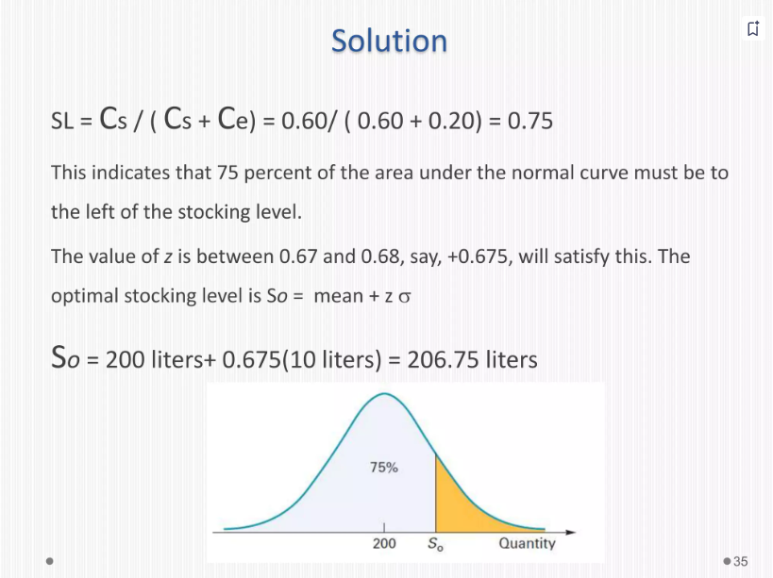

Slide 37
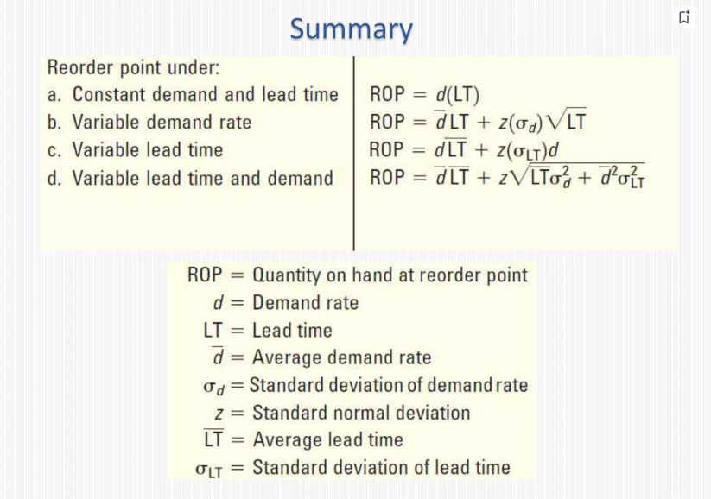

Slide 38
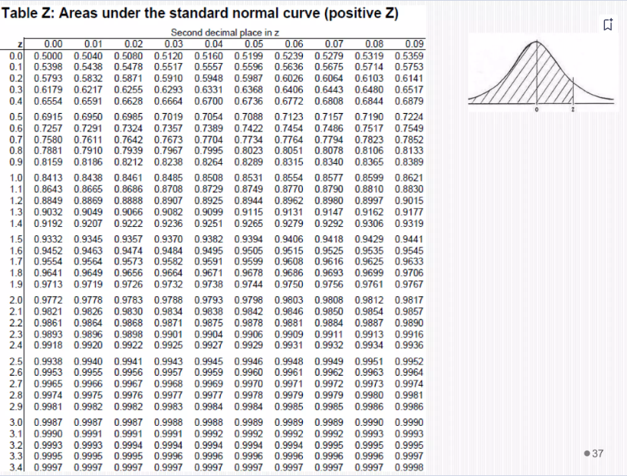

Slide 39
Lead-time demand occurs in an inventory system when the lead time is not instantaneous. The lead time is the time from placement of an order until the order is received. Assume that lead time is a random variable. During the lead time, demands also occur at random. Lead-time demand is thus a random variable defined as the sum of the demands over the lead time, denoted as EizoD, where T is the time period of the lead time, i=0,1,2, D is the demand during the ith time period, and T is the lead time. The distribution of lead time demand is found by simulating many cycles of lead time and building a histogram based on the results.
A firm sells bulk rolls of newsprint. The daily demand is given by the following probability distribution:
Daily Demand (Rolls) Probability
0 0.20
1 0.35
2 0.30
3 0.15
The lead time is the number of days from placing an order until the firm receives the order from the supplier. In this instance, lead time is a random variable given by the following distribution:
Lead Time (Days) Probability
0 0.36
1 0.42
2 0.22

Slide 40
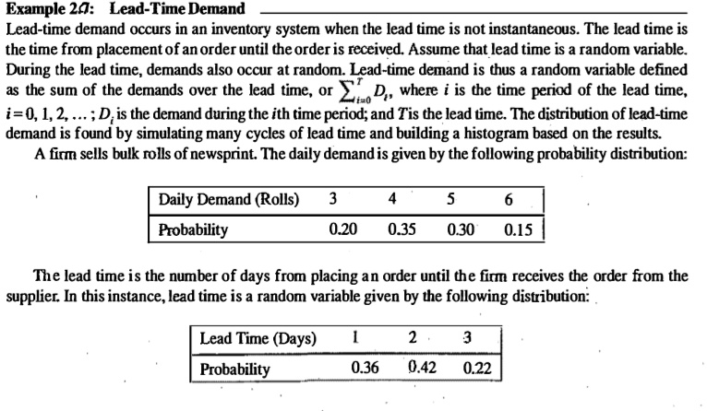

Slide 41
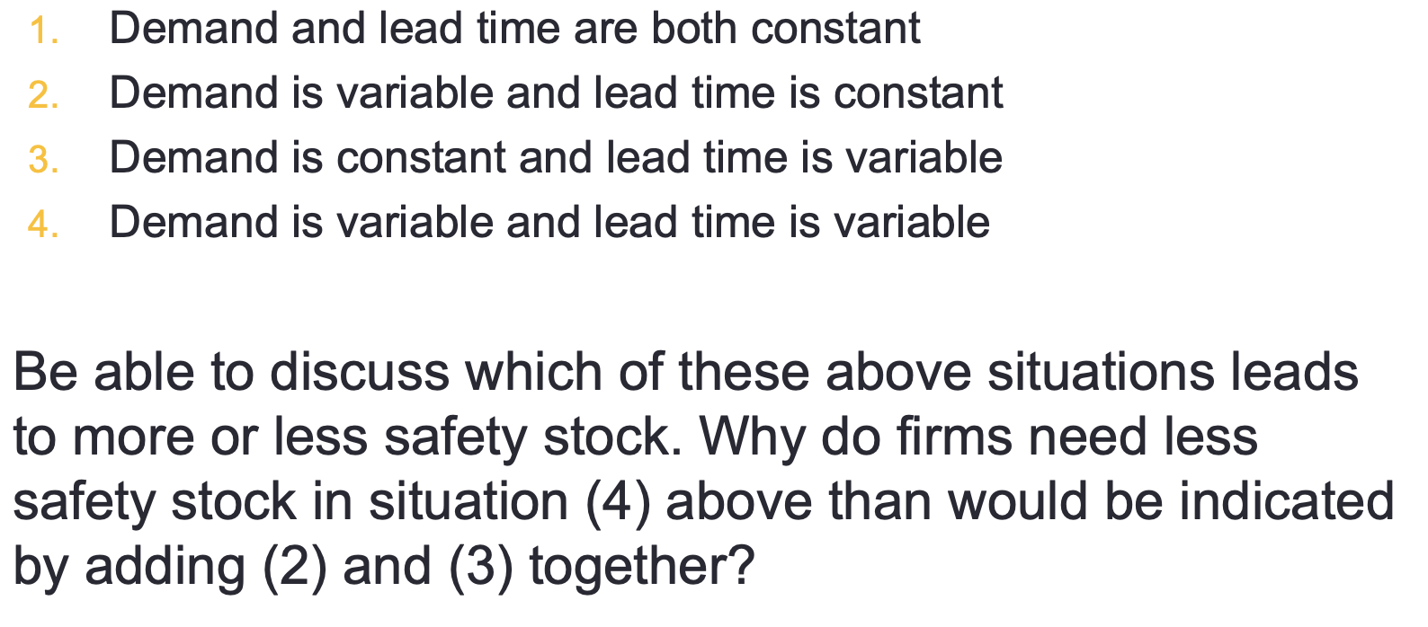

Slide 42
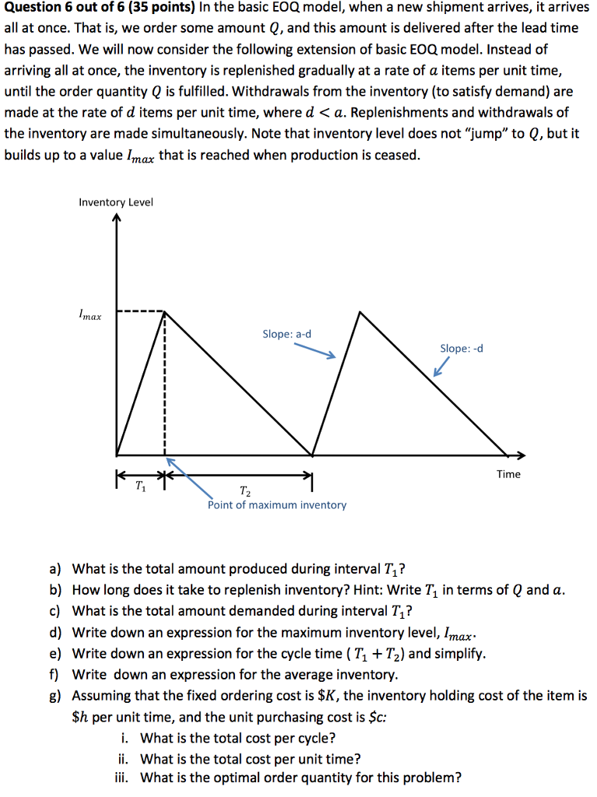

Slide 43
